Slide 1

Email Sentiment analysis
Aaron Morgan, David Romaine, Kevin Cha, Nahielys La Fontaine

Slide 2
project overview
Originally wanted to use unstructured machine learning to detect fraud
Performed sentiment analysis to systematically identify, quantify, and study affective states and subjective information

Slide 3
DATA SET
Primary dataset included 500,000 Enron emails
obtained by the Federal Energy Regulatory Commission
Challenging to interpret using traditional methods due to unstructured nature
Required additional mining steps and many integrity checks in order to minimize any possible inconsistencies

Slide 4
Methodology
Trained model using 500,000 Enron emails
Used ETL to extract body and headers from email data
Used the Naïve Bayes Classifier to determine positive, negative, or neutral sentiment

Slide 5
eNRON Overview
Enron was ranked as America's fifth largest company by Fortune magazine in 2002, despite its 2001 bankruptcy filing.
An independent review published in 2002 detailed how executives pocketed millions of dollars from complex, off-the-books partnerships while reporting inflated profits to shareholders.
Executives including Kenneth Lay and Jeffrey Skilling were prosecuted for fraud-related crimes.
Key figures sold their stock shortly before the company announced a sharp downturn in earnings.
Lower-level employees were encouraged to invest in company stock for their retirement savings just before the company collapsed. The workers later filed a class action lawsuit and won an $85 million settlement.

Slide 6
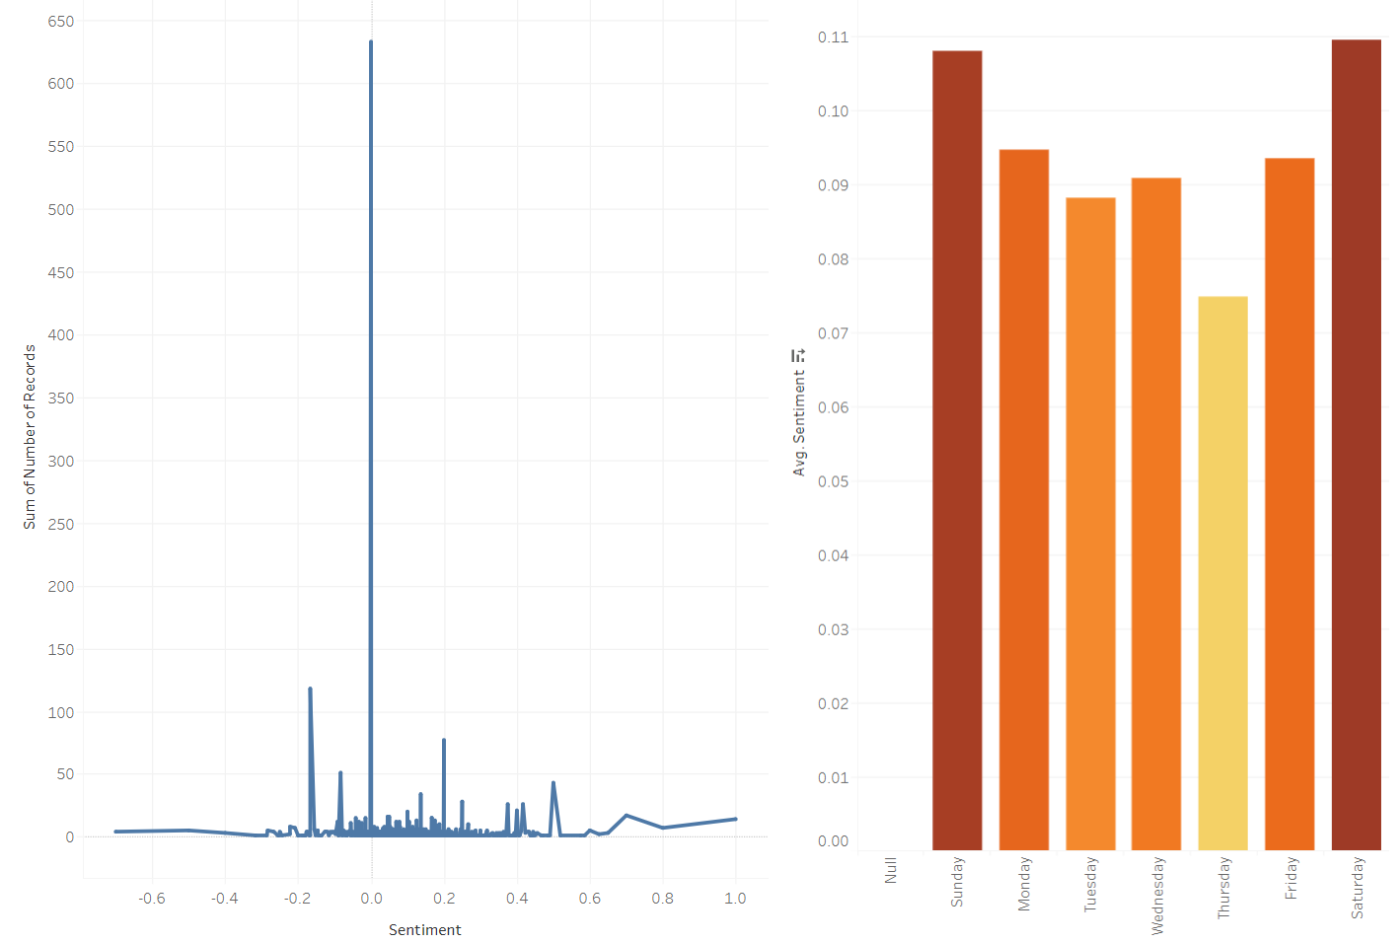
Record by sentiment | AVG Sentiment by Day

Slide 7
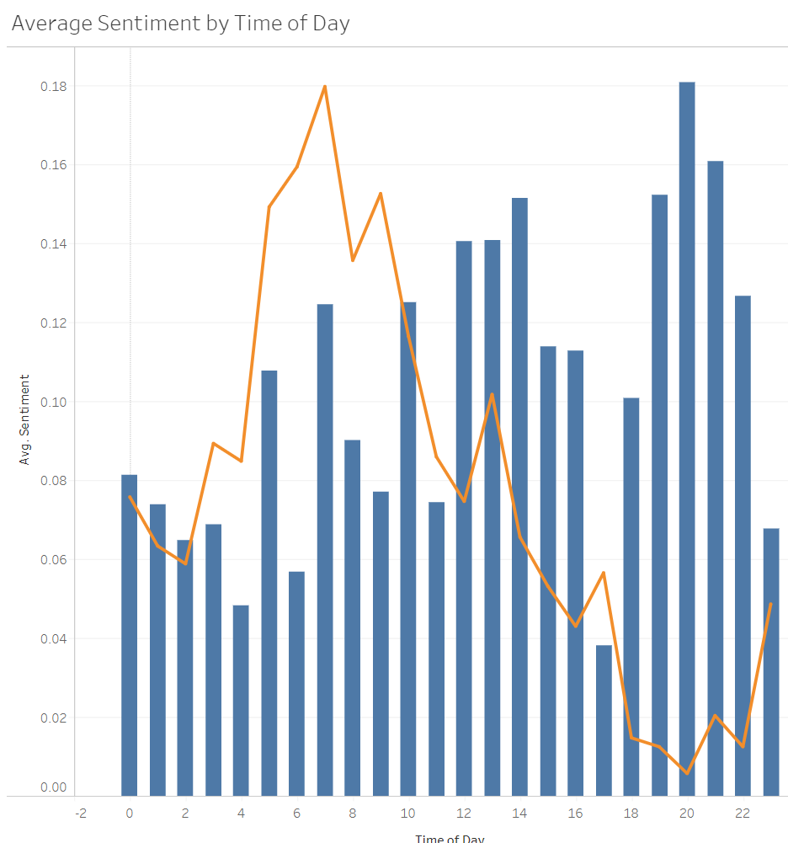
Average sentiment by time of day

Slide 8
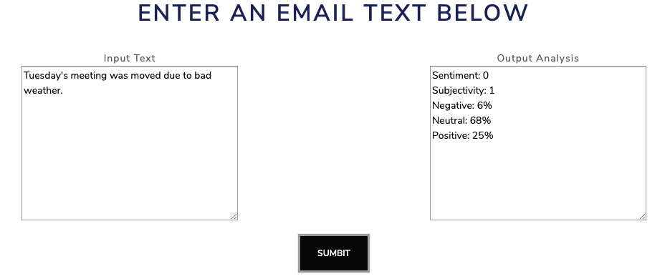
Solution interface

Slide 9
Summary
Still unclear as to whether sentiment analysis on this dataset could have been used to detect and prevent fraud at Enron
However, we are confident it can be used as an investigation tool to augment other processes designed to detect fraud at other institutions
Recommend further research focusing training data on specific employees who were later charged with fraud, like Kenneth Lay and Jeffrey Skilling

